Slide 1
STEM: Engineering Is at the Heart of It
Pramod P. Khargonekar
NSF Directorate for Engineering
June 23, 2013
STEMSmart

Slide 2
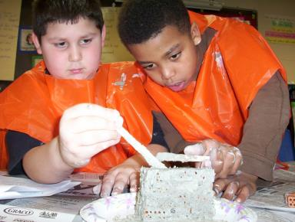
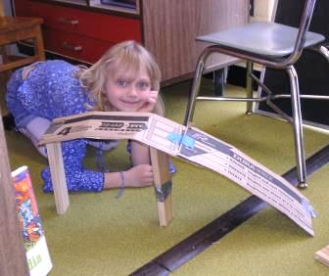
Why Engineering in K-12?
Notes:
Image from TeachEngineering.org

Slide 3
Educational Context is Changing
Great societal interest in successful K-12 STEM education
Very large fraction of STEM jobs will be in engineering and technology
Engineering is woven throughout the Next Generation Science Standards
Employers are looking for “soft skills” such as teamwork, communication, problem solving
Technology is increasingly integrated into our lives

Slide 4
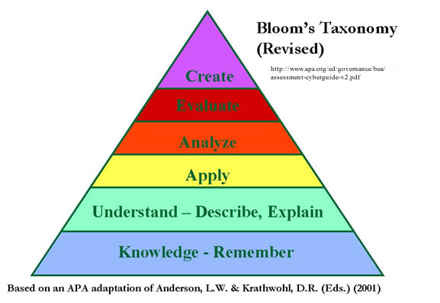
Engineering improves understanding of science and math topics
Provides meaning, real-world applications
Provides integration across disciplines
Provides inquiry- and project-based exploration of the world
Can start in elementary grades
From knowing to creating

Slide 5
Engineering is Fun!
Encourages collaboration
Empowers through problem solving
Encourages creativity
Engages and inspires all kinds of students

Slide 6

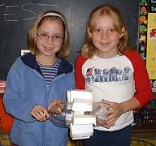
How to integrate Engineering?

Slide 7
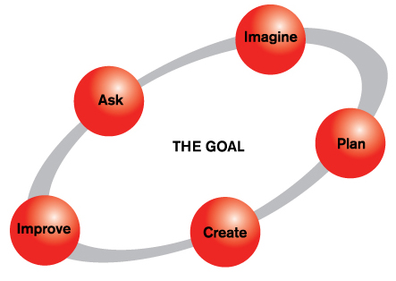
What is Engineering?
The engineering process, according to Engineering is Elementary
Kids love to do these things!

Slide 8
Engineering in the K-12 Classroom
Start with core math, science, and technology
Build on these when introducing engineering design activities into existing curricula
Use existing resources and appropriate engineering examples – engineering serves as a unifying topic, emphasizes the interconnectedness of STEM subjects
Notes:
From “Engineering in K-12 Education: Understanding the Status and Improving the Prospects” (p.5) – “Certain science concepts as well as the use of scientific inquiry methods can support engineering design activities. Similarly, certain mathematical concepts and computational methods can support engineering design, especially in service of analysis and modeling. Technology and technology concepts can illustrate the outcomes of engineering design, provide opportunities for “reverse engineering” activities, and encourage the consideration of social, environmental, and other impacts of engineering design decisions.”

Slide 9
Engineering Activities
Project-based learning
  Best if real-world projects
  Even better if projects include service learning (helping people with disabilities, helping the environment)
Work done in teams
  Students learn collaboration and compromise
  They learn to use their own strengths to fit a specific situation, using their talents to be valued by the team
Open-ended problems
  No “one right solution”
  Special needs students thrive in these settings

Slide 10
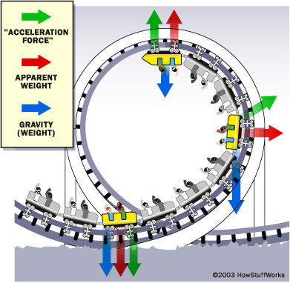
It’s Roller Coaster Season!

Slide 11
The Physics of Roller Coasters
(from www.teachengineering.org/)
Grade 7 activity
Uses students’ existing physics knowledge of forces, gravity and friction, Newton’s Second Law of Motion, position, velocity, acceleration, and kinetic and potential energy
Students explore the most basic physical principles of roller coasters, which are crucial to the initial design process for engineers building roller coasters
Students explore the physics used by engineers in designing today’s roller coasters, including potential and kinetic energy, friction, and gravity
Afterwards, students will be able to analyze the motion of any existing gravity-driven coaster and design the basics of their own roller coasters
During an associated activity, the students design, build, and analyze a roller coaster for marbles out of foam tubing

Slide 12
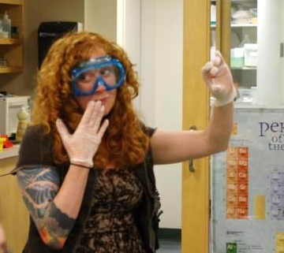
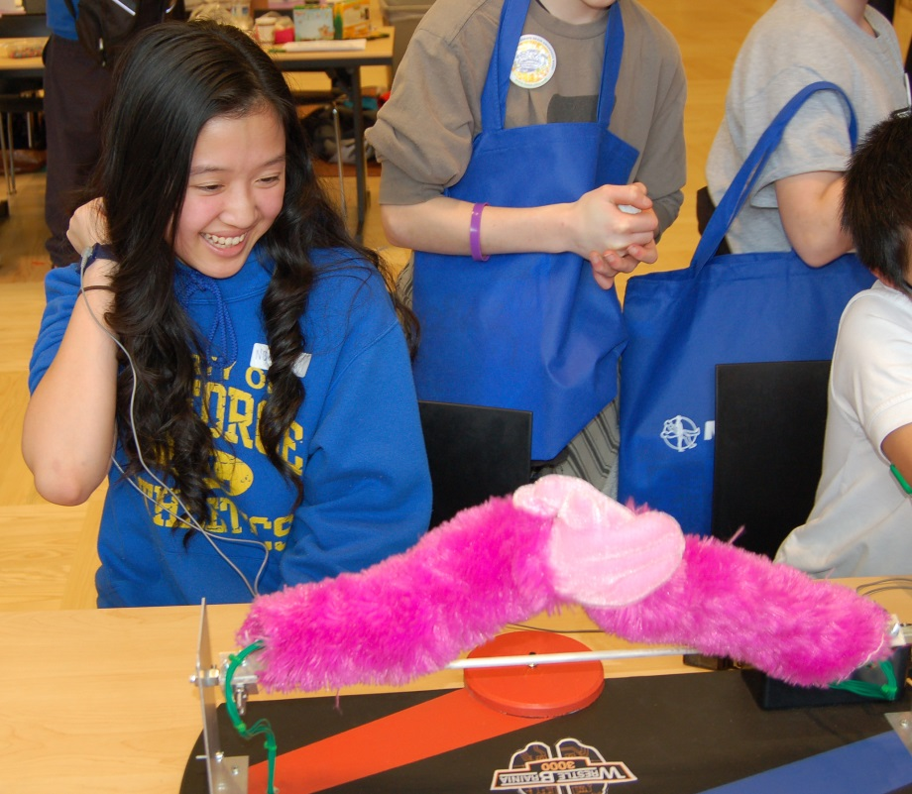
What Engineering resources Are there?
Notes:
LEFT: An RET teacher in the lab…
RIGHT: A student competes at arm-wrestling using CSNE’s WrestleBrainia 3000 game at the 2013 University of Washington Brain Awareness Week Open House. (Credit: Eric Chudler)

Slide 13
Informal Education
Maker Movement (http://makerfaire.com)
Hacker Scouts (www.Hacker-Scouts.org)
Industry activities
  Intel Science Talent Search
Professional Societies
  National Engineers Week (www.futurecity.org)

Slide 14
NSF Example Projects
Integrating Engineering and Literacy at Tufts University
Studio STEM at Virginia Tech
UTeach Engineering at University of Texas at Austin

Slide 15
NSF Partnerships – RETs
NSF Research Experiences for Teachers
  STEM teachers perform engineering and computer science research and translate their research experiences and new knowledge into classroom activities
  90 sites, 500 teachers per year
  www.ret-eec.org

Slide 16
NSF Partnerships - ERCs
NSF Engineering Research Centers
  Build relationships with K-12 teachers and students to help integrate engineering concepts
  into precollege education
  Over 46,000 K-12 students participated in ERC outreach programs in 2012.
  www.erc-assoc.org

Slide 17
Classroom Resources
Engineering is Elementary www.eie.org
Engineering, Go for It! www.egfi-k12.org
Engineering Pathway www.engineeringpathway.org
Engineer Your World www.engineeryourworld.org
Teach Engineering www.teachengineering.org

Slide 18
Engineering Ecosystem
Engineering colleges spread throughout the nation
Faculty, graduate students, undergraduate students, deans, department chairs, …
Practicing engineers in industry
Government labs
Enormous untapped resources

Slide 19


Slide 20
Conclusions
Infusing engineering into K-12 STEM education offers a novel direction to address a critical educational and societal challenge
NSF is supporting and catalyzing this change
Engineering community will engage
We will all benefit from the change
Questions?
pkhargon@nsf.gov

