Slide 1
Making a difference in the world: Engineering in middle school math and science classrooms*
Presenters: Amy Wendt and Amy Schiebel
STEM Smart NSF Workshop
Atlanta, GA, June 22, 2013
*Results from “Society's Grand Challenges for Engineering as a context for middle school STEM instruction,” NSF Award #1030126 (ITEST) with additional support from the Young Scientists of America and Plexus Charitable Foundation

Slide 2


Next Generation Science Standards (NGSS): middle school sciences
Physical: Performance expectations…blend core ideas with scientific and engineering practices
Life: Evaluate competing design solutions …for ecosystem services
Space and Earth: … strong human connection to engineering through the instruments and technologies that have allowed us to explore the objects in our solar system
Human Impacts: Students understand the ways that human activities impact Earth’s other systems

Slide 3
NGSS: middle school engineering
Disciplinary core ideas:
Defining and delimiting engineering problems
Developing possible solutions
Optimizing the design solution
Crosscutting Concepts:
Influence of science, engineering and technology on society and the natural world

Slide 4
NGSS: Integration and the practices of science and engineering
Scientists:
Ask questions
Develop/use models
Plan/execute investigations
Analyze/interpret data
Use math and computational thinking
Construct explanations
Engage in argument from evidence
Obtain, evaluate, communicate information
Engineers:
Define problems
Develop/use models
Plan/execute investigations
Analyze/interpret data
Use math and computational thinking
Design solutions
Engage in argument from evidence
Obtain, evaluate, communicate information

Slide 5
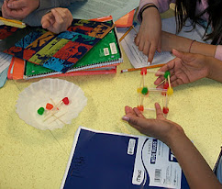
Do widely available activities meet NGSS engineering standards?
Google search for instructional resources:
“bridge building activity” : 47,000,000 results in Google
“bridge building activity for students” : 3,120,000 results in Google
“tower activity for students” : 92,800,000 results in Google

Slide 6
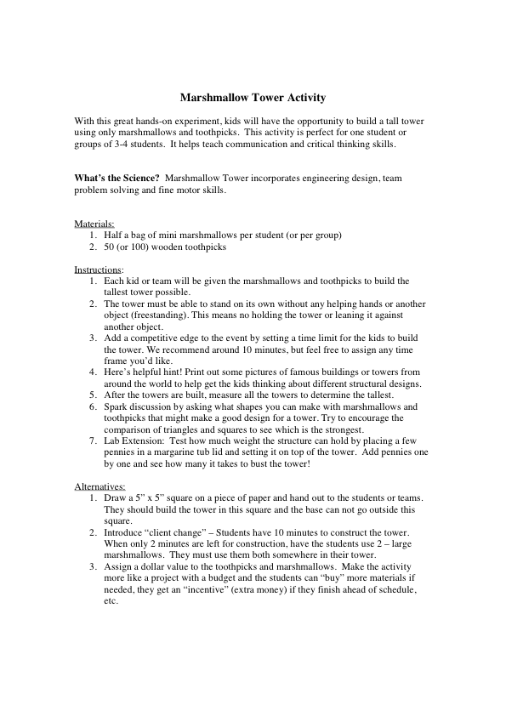
Consider an example: top of the list of Google Search hits

Slide 7
Marshmallow Tower
Engineering elements included?
Forces? – no connection to science core ideas
Design is included, but in a limited way
Engineering elements not included?
The function of the structure and associated constraints are not specified
No time to design, test and refine design (iterative design process)
Strength of squares vs. triangles: a discussion – but nothing further - is suggested
Misconceptions reinforced?
Building structures and engineering are not synonymous
Competition for tallest tower - engineering is not a competitive sport!

Slide 8
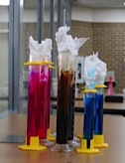

Engineering is as broad as the human experience and as sophisticated as our societies
Design of safe buildings and bridges does require engineering, but engineering addresses human needs in many ways
Exposure to science in a variety of different engineering contexts may:
Help connect science concepts to students’ own experiences
Improve comprehension and retention of science concepts
Break down inaccurate stereotypes of engineering
Engage students with diverse backgrounds/interests

Slide 9
Society's Grand Challenges for Engineering as a context for middle school STEM instruction NSF Award #1030126 Innovative Technology Experiences for Students and Teachers (ITEST) with additional support from the Young Scientists of America and Plexus Charitable Foundation
Investigators:
Amy Wendt, Susan Hagness and Steven Cramer (Engineering, UW)
Kimberly Howard (Education, Boston University)

Slide 10
UW “Grand Challenges”
Project goal:
create interest in engineering among a larger and more diverse population of middle school students
Strategy (2010-2013):
Society’s Grand Challenges for Engineering embedded in core math and science curriculum
“Summer institute” for teachers/school staff in 2011 and 2012
Curriculum modules piloted in 6 partner schools
Research study -- collect and use data to:
evaluate:
classroom implementation of instructional materials
Effect on student and teacher perceptions about engineering careers, science and math
improve/expand instructional resources

Slide 11
Making a difference in the world
Women’s Experiences in College Engineering Project (2001)
A top reason why women enter engineering:
attraction to the altruistic kind of work engineers do
Critical factor in retention:
exposing women early on to how engineering has led to improvements in society and the quality of people’s lives
“Extraordinary Women Engineers” high school survey (2005)
Survey results show that girls:
often don’t know what engineering is
think it is only for those with innate love of math and science
However, they:
want to be creative and “make a difference”
react positively to personal stories about engineering lifestyles
Peers and educators are key influencers and motivators

Slide 12
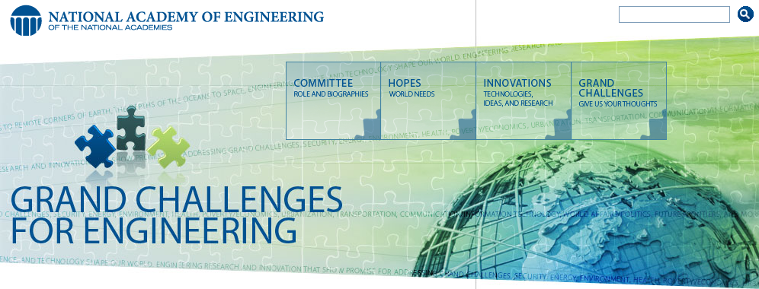
Grand Challenges for Engineering
http://www.engineeringchallenges.org/
Health
Advance health informatics
Engineer better medicine
Reverse-engineer the brain
Joy of Living
Enhance virtual reality
Advance personalized learning
Engineer the tools of scientific discovery
Sustainability
Make solar power economical
Provide energy from fusion
Develop carbon sequestration methods
Manage the nitrogen cycle
Provide access to clean water
Restore and improve urban infrastructure
Vulnerability
Prevent nuclear terror
Secure cyberspace

Slide 13
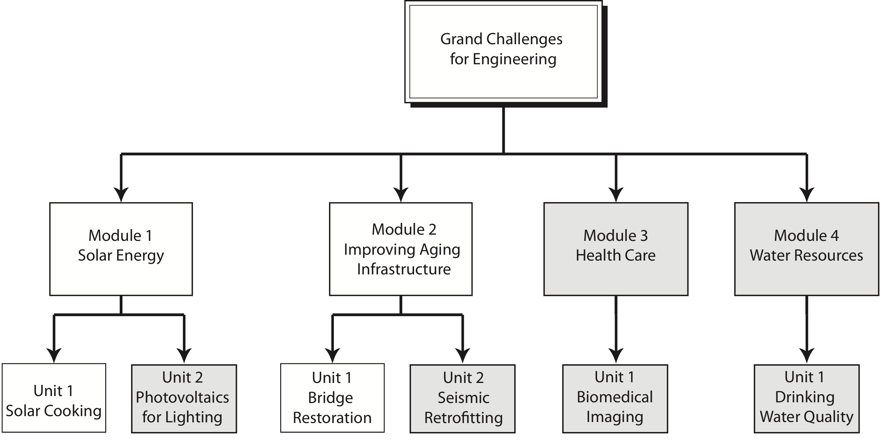
GCE Instructional Modules and Units
• shaded boxes = new for 2012-2013

Slide 14
Engineering concepts that guided development of the GCE modules
Iterative design process, refinement of design
Societal context
Application of math and science concepts
Collaborative activities

Slide 15
Activities link math/science concepts to Grand Challenges – Municipal Infrastructure
Infrastructure example
Aging bridge story line:
age-compromised strength
increased performance needs due to expanded population
Students develop math and science skills as they
role-play as engineers
build and test scale-model truss bridge
make recommendations to city council on whether to repair or relocate bridge based on:
load-bearing capacity needs
cost
environmental impact
impact on nearby communities

Slide 16
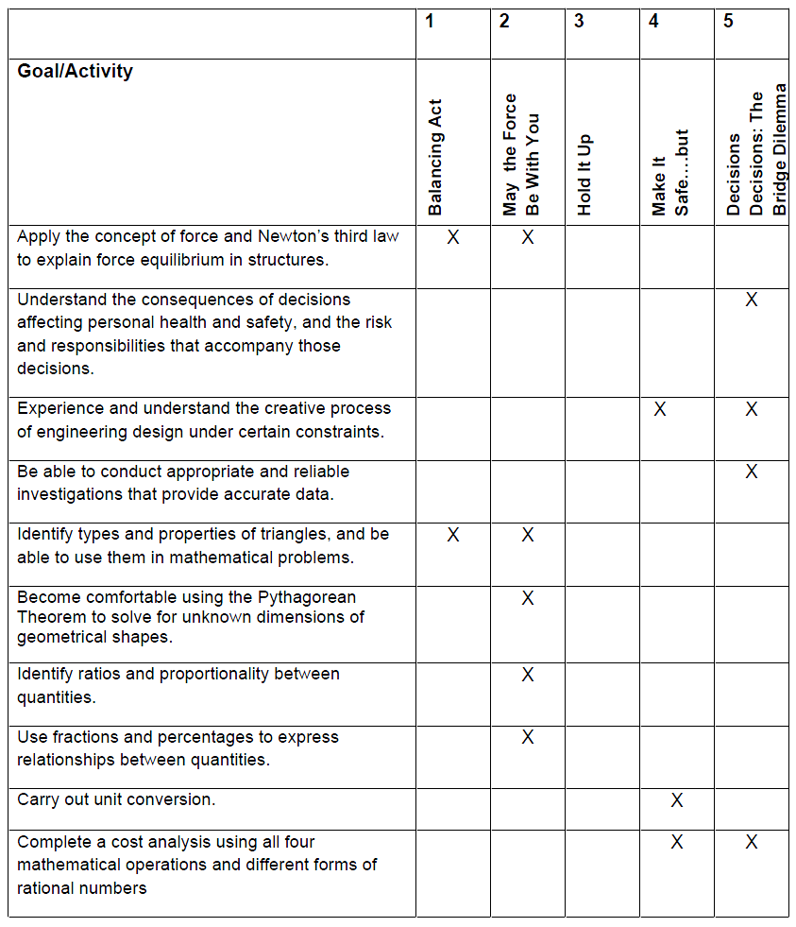
Infrastructure Goals and Activities
X

Slide 17
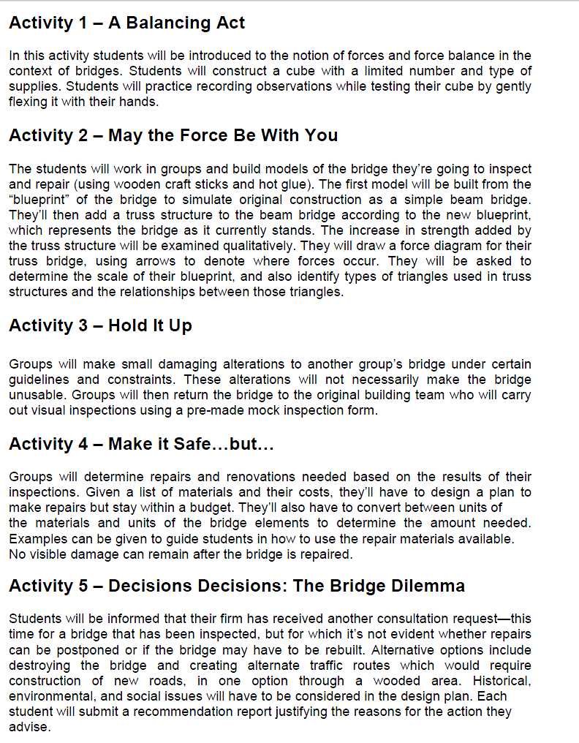
Bridge restoration – engineering concepts
Science and Math:
Activity 1 – A Balancing Act
…students will be introduced to the notion of forces and force balance in the context of bridges…
Collaborative Activities:
Activity 2 – May the Force Be With You
The students will work in groups and build models …
Iterative Design Process:
Activity 4 – Make it Safe…but…
Groups will determine repairs and renovations needed based on…
Societal Context:
Activity 5 – Decisions Decisions: The Bridge Dilemma
…. Alternative options... Historical, environmental, and social issues will have to be considered in the design plan. …

Slide 18
Bridges Activity 5: example of curriculum materials
Improving Aging Infrastructure: Bridges
Activity 5: “Decisions, Decisions: The Bridge Dilemma”
Handouts – Student guide, teachers guide/student sheets

Slide 19

Students evaluate bridge design considerations
8th graders recorded at Edgewood Campus School

Slide 20
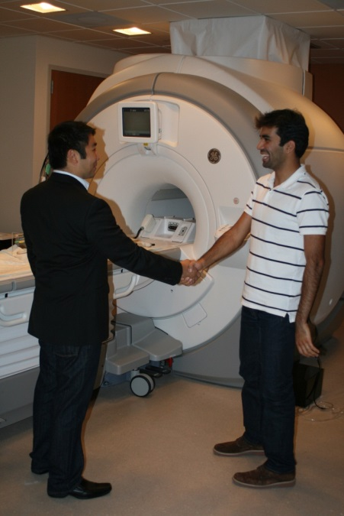
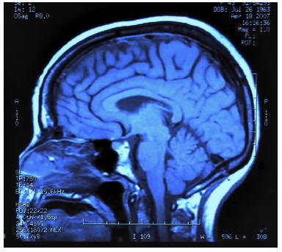
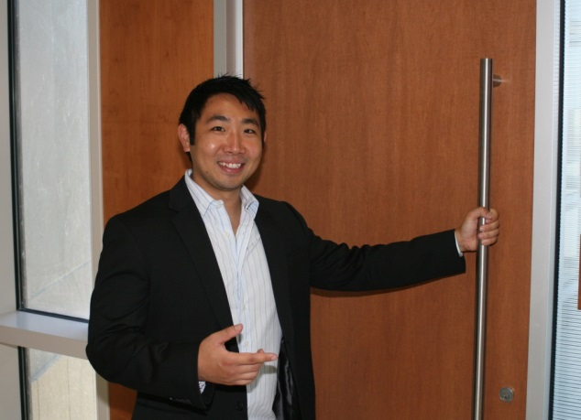
Activities link math/science concepts to Grand Challenges – Health Care
Biomedical imaging
Story line:
Students go on a (virtual) visit to a research laboratory in a biomedical engineering company
Engineers in this lab are developing, testing, and refining new technologies for diagnostic imaging
Students assist with some of the research and development

Slide 21
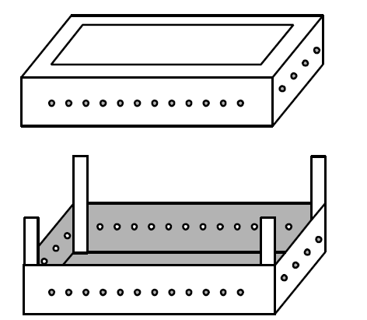
Activities link math/science concepts to Grand Challenges – Health Care
Biomedical imaging
Students develop math and science skills as they
role-play as engineers
design and implement an imaging technique to determine the shape of a hidden object inside a box
create a (fictionalized) predictive mathematical model for tumor classification

Slide 22
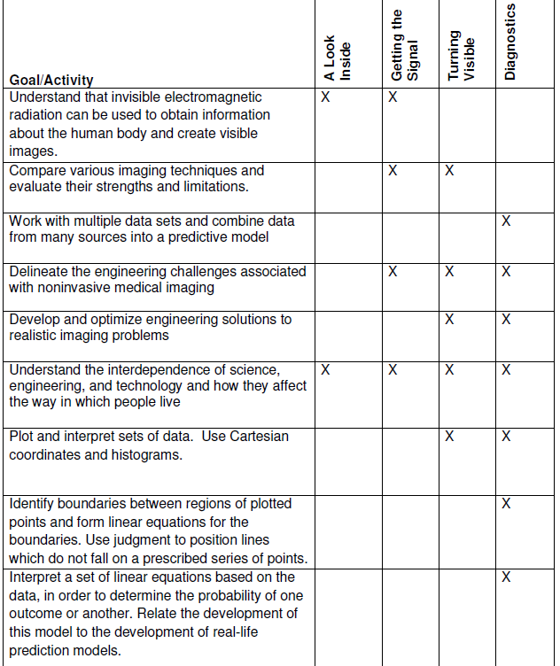
Biomedical Imaging Unit: Goals and Activities

Slide 23
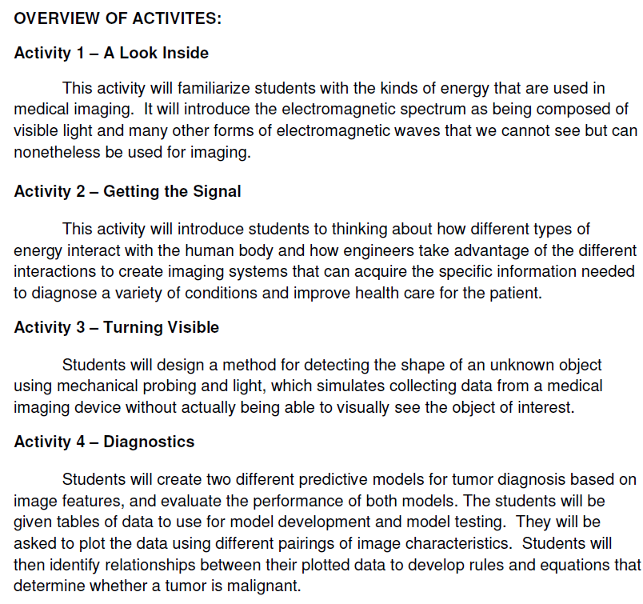
Biomedical imaging - engineering concepts
Iterative design process:
How would you change the design of the box to get a better or more versatile imaging device?
Collaborative activities:
Solving challenges in health care requires contributions from a diverse team of engineers…
Working with your team, develop a procedure, including a signal processing plan…
Math and science:
You will create a mathematical model from health care data…
Societal context:
…to help physicians make diagnostic decisions…

Slide 24
Biomedical Imaging Activity 3: example of curriculum materials
Health Care: Biomedical Imaging
Activity 3: “Turning Visible”
Handouts – Student guide, teachers guide/student sheets

Slide 25
Summary
Integration of engineering into math/science curriculum
Key engineering elements:
Iterative design process, refinement of design
Societal context
Application of math and science concepts
Collaborative activities
Stereotypes: building of structures may or may not use engineering; it certainly does not define engineering
Societal context: engineering can be found in every aspect of the human experience
Engineering and science are symbiotic, but different
Science = testable explanations of our universe
Engineering = application of science in a structured process to solve problems of human need
Engineering is as broad as the human experience and as sophisticated as our societies

Slide 26
Grand Challenges Instructional Modules
Because this is an active research project…
Units not yet available for widespread distribution
Instructional unit pilot took place 2011-2013
Data collection and analysis is continuing
Unit revisions expected
If you are interested in being contacted about instructional module availability
Please sign up!
Sign up lists are being circulated

Slide 27
Acknowledgments
Curriculum development
Amy Schiebel – Edgewood College
Tam Mayeshiba
Lauren Aneskavich
Kevin Cheng
Benjamin Crary
Jean DeMerit
Kevin Anderson
Steven Cramer
Susan Hagness
Amy Wendt
Research
Kimberly Howard – Boston University
Jake Diestelman
Tsu-Lun Huang
Evaluator
Karen O’Brien – University of Maryland
Support
NSF grant DRL-1020126
Young Scientists of America
Plexus Foundation

