Slide 1
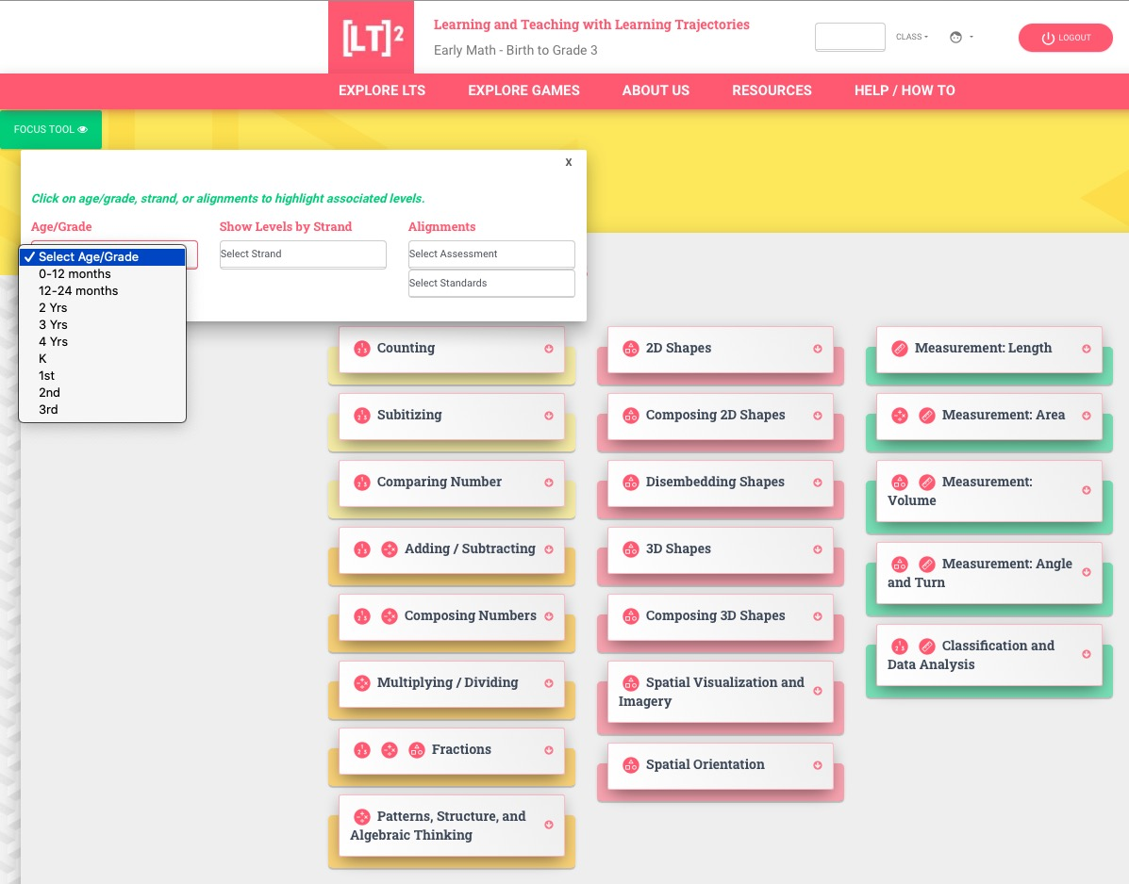
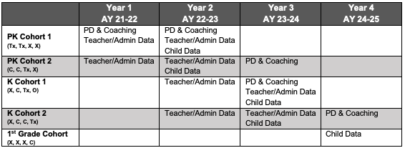
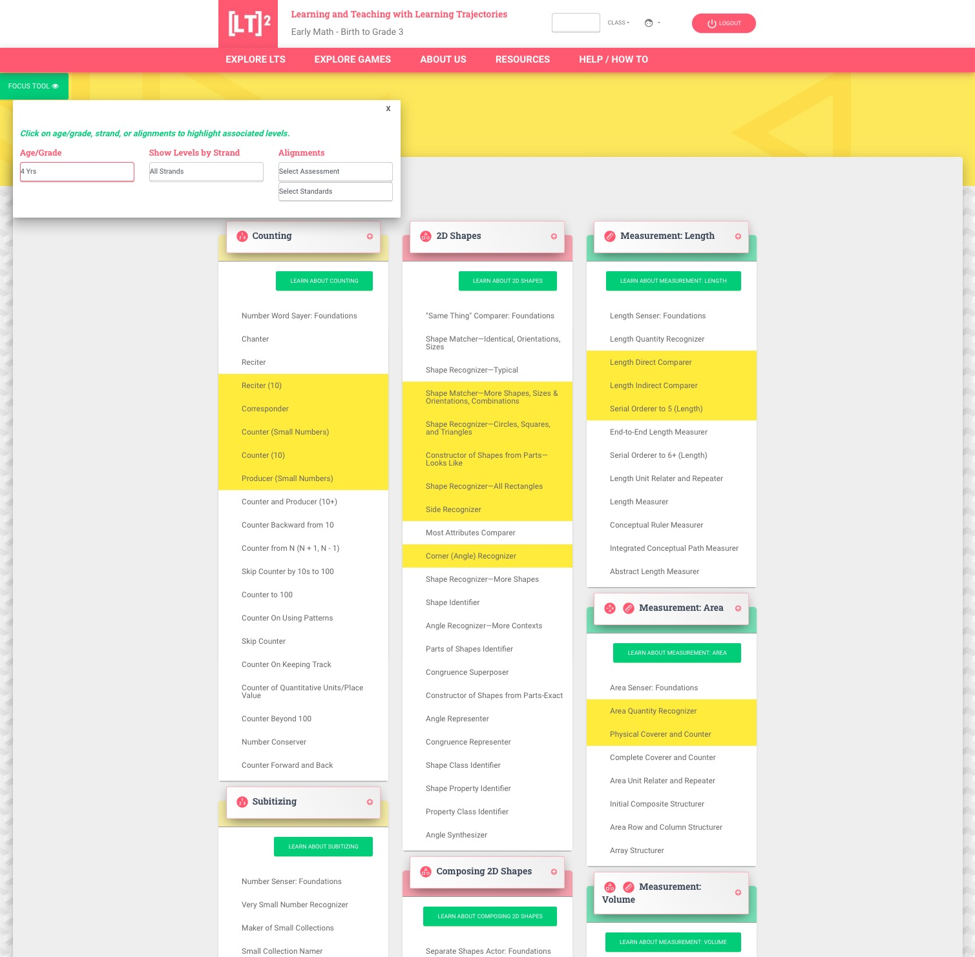
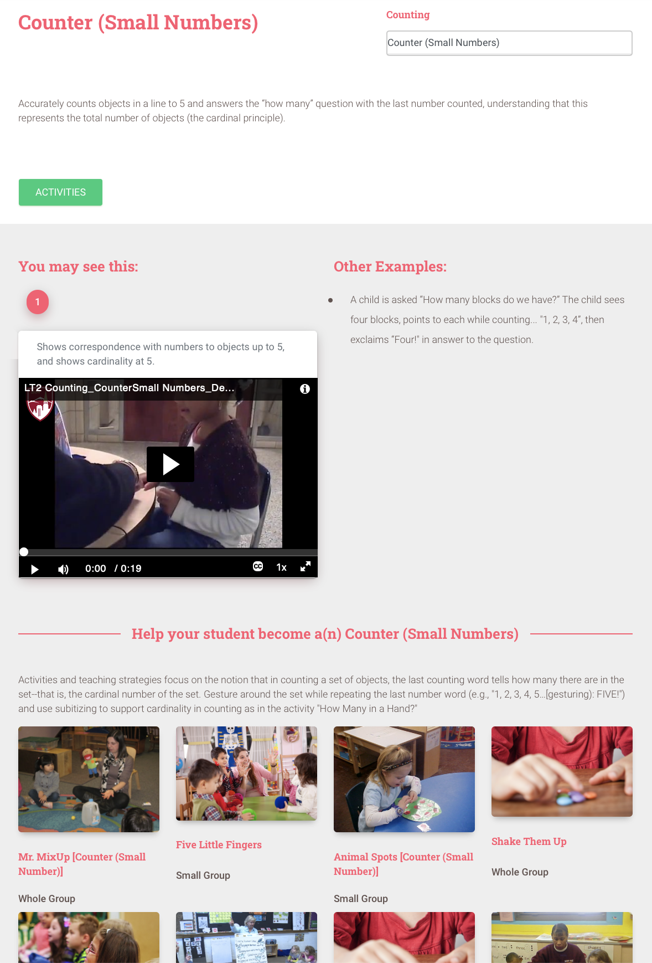
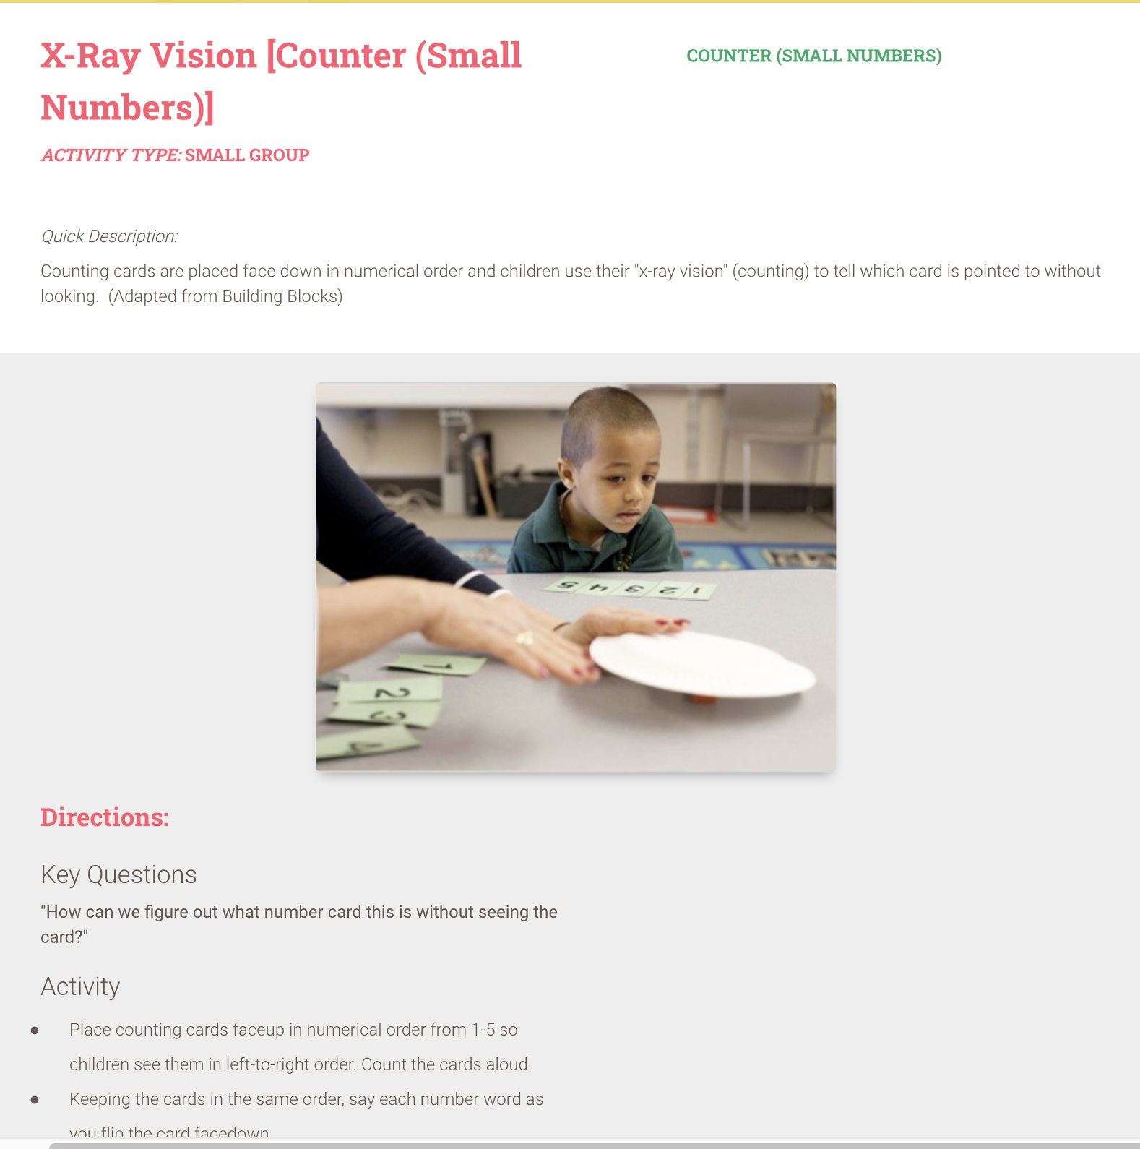
Understanding Learning Trajectories in Math: Advancing Teacher Education
(ULTIMATE)
Douglas H. Clements, Julie Sarama, Crystal Day-Hess, & Shannon Stark Guss
Project Aims
Over two decades, we have built a professional development tool, called Learning and Teaching with Learning Trajectories, or [LT]².
Study Design Overview
• We will use a randomized delayed cohort design to answer our research questions.
• Teachers in PK and K will receive PD and coaching based at different periods on their randomized cohort assignment.
• Once children have been part of a data collection wave, we intend to follow them through consecutive grades throughout the course of the study, providing us with longitudinal data for most children.
Tx = Treatment/[LT]² Intervention Group, C = Control Group (data only), X = No Study Activities
This research project will support teachers in deepening their understanding of how children learn mathematics and how to incorporate this understanding into their classrooms to help children develop math ideas and skills—joyfully. Blending high quality in-person professional development and classroom-based coaching all centered around the Learning and Teaching with Learning (LTLT, or [LT]²) tool, researchers will investigate positive impacts of both teachers’ development and students' learning of mathematics.
Learning trajectories (LTs) are presented for multiple topics important in early math learning. The focus tool at the upper left allow choosing an age/grade or alignments to standards and assessments.
Research Questions
The evaluation is designed to answer three primary research questions:
What are the short- and long-term effects of the ULTIMATE project on student achievement and the distribution of achievement across socio-demographic student subgroups?
What are the short- and long-term effects of the ULTIMATE project on teacher instructional approaches, beliefs, and quality?
How cost-effective is the Learning Trajectories ULTIMATE project relative to the original Building Blocks curriculum intervention?
Opening LTs shows the developmental progressions—levels of thinking, birth to grade 3. Note the focus tool is highlighting those levels usual for a given age.
Measures
• My-COEMET (coach visits): Teacher self-report of quantity and quality of
early math practices
•COEMET (Fall, Spring): Classroom observations of quantity and quality of
early math
• Math Teacher Questionnaire (Fall, Spring): Math beliefs/practices
• Math Principal Questionnaire (Fall, Spring): Math beliefs/practices
• REMA (Fall, Spring): Child math achievement
Selecting a level describes the developmental pattern of thinking in text, videos, and documents. Under that are many instructional activities described in text, videos, and documents with pdfs of the whole activity, materials, etc.
The [LT]² tool is a substantial update of the online tools that were fundamental supports LT-based professional development. [LT]² runs on multiple technological platforms and addresses a wide age range (birth to age 8 years). Updates include: the addition of new LTs, or topics, new alignments with standards and assessments, new videos of the levels of developmental progressions and of instructional activities, new software for children, adaptations for people with disabilities, and new resources.
[LT]² was formatively evaluated/refined through 4 phases: case studies and surveys with teachers; game testing with children; reviews of quality and usability, including interviews of teachers.

