Slide 1
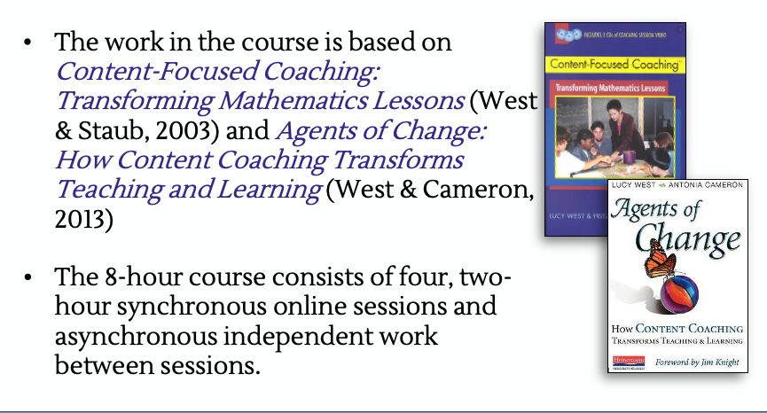
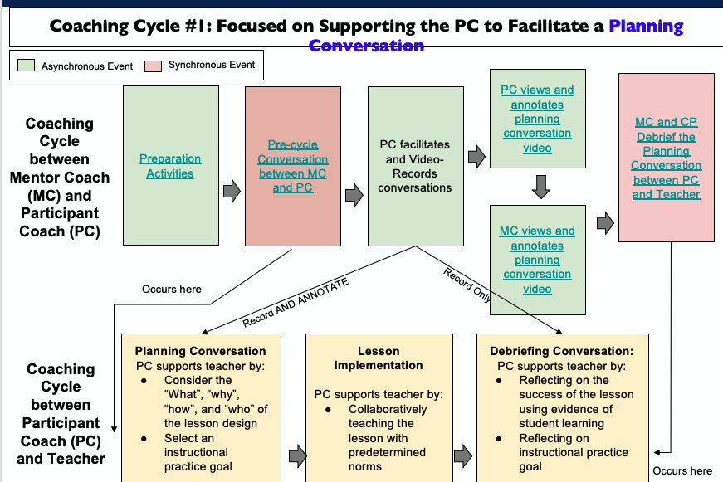
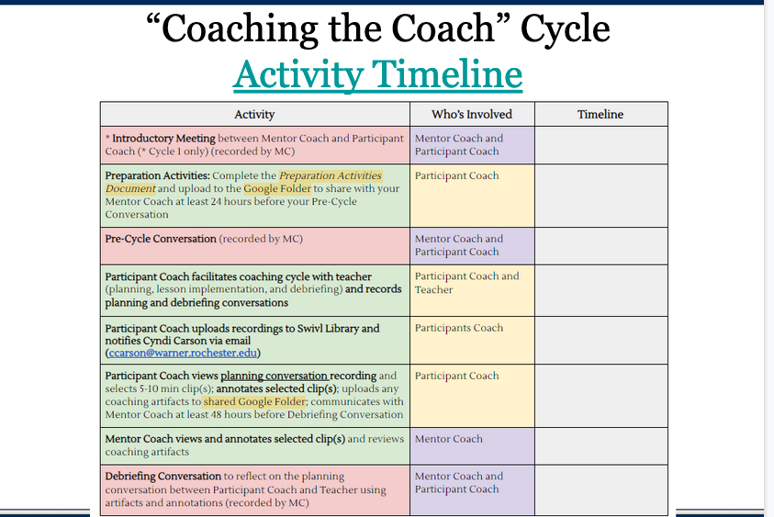
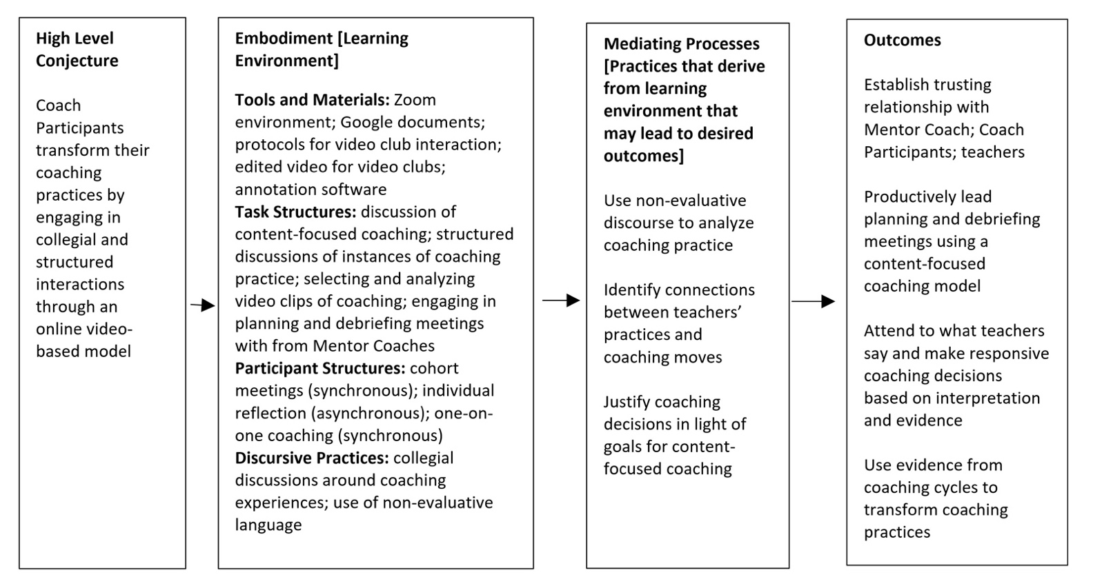
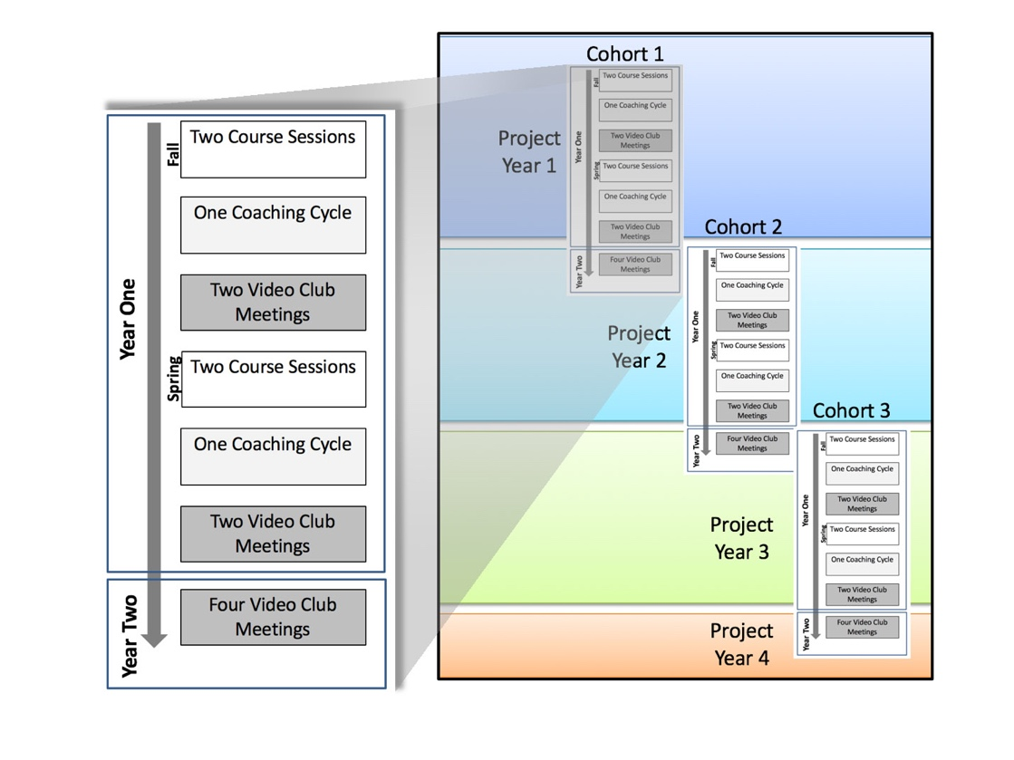
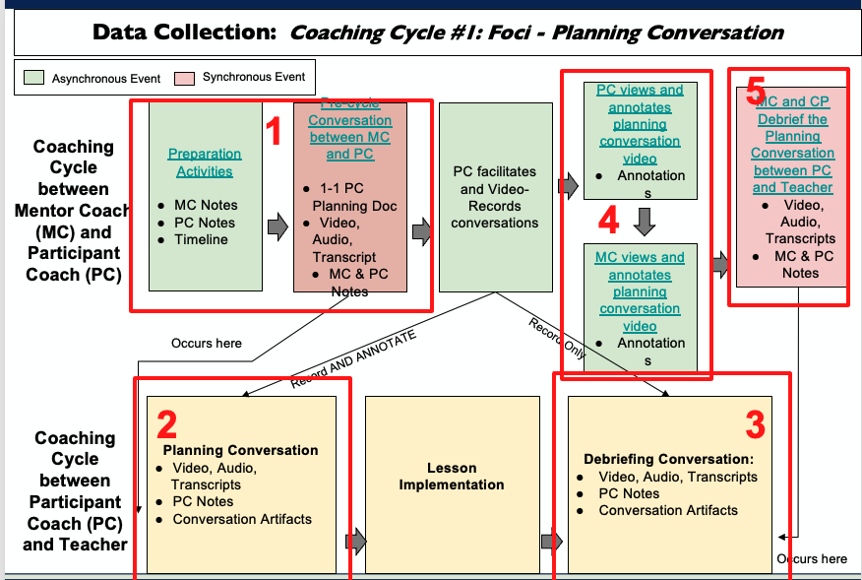
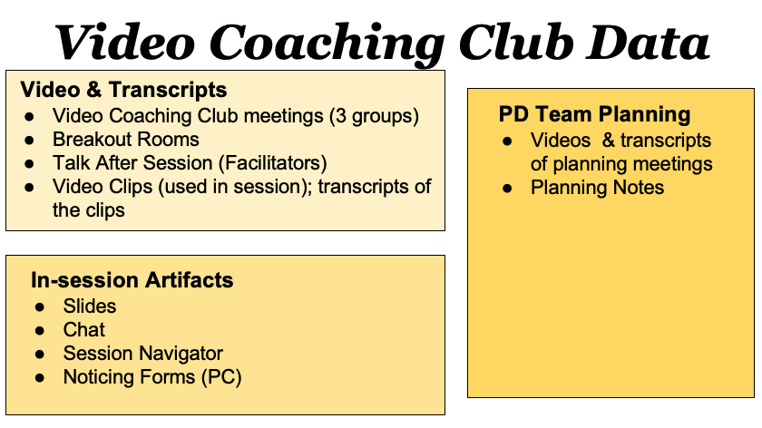
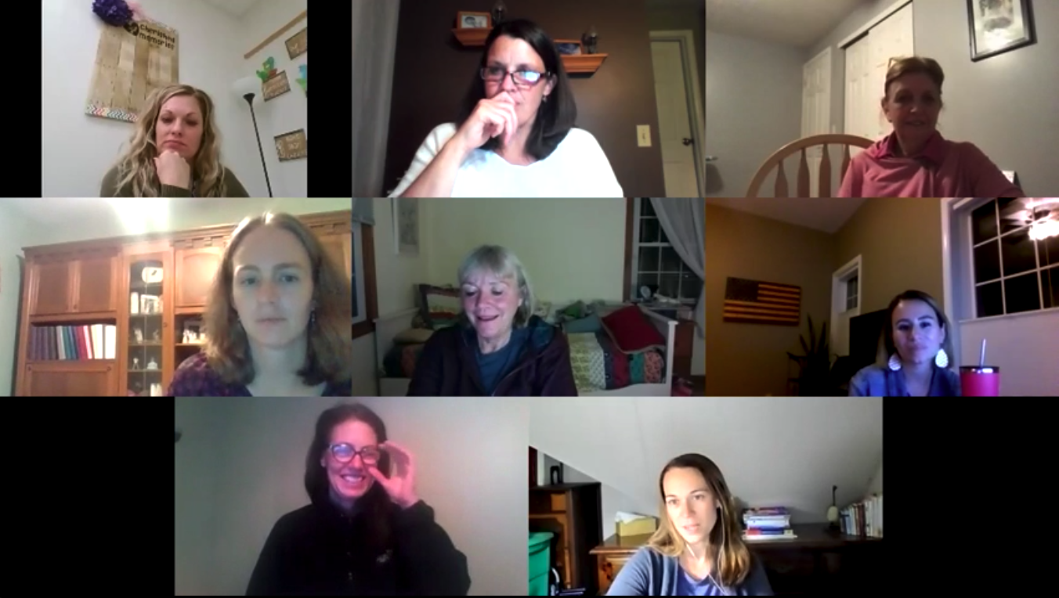
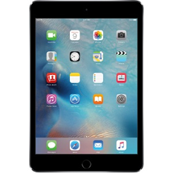
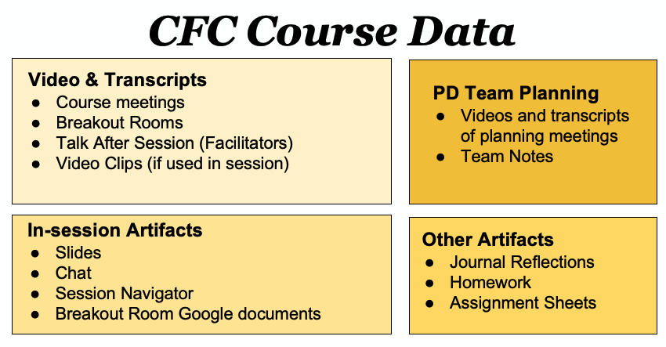
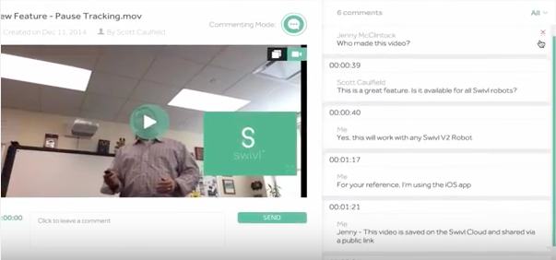
Collaborative Research: Synchronous Online Video-Based Development for Rural Mathematics Coaches [SyncOn for Coaches]
Julie Amador, University of Idaho; Jeffrey Choppin, University of Rochester; Cynthia Callard, University of Rochester
Purpose
Research Questions
Main PD Components
Coaching Cycle
The goal of the project is to support mathematics coaches in rural contexts to improve their ability to (a) facilitate productive planning and debriefing conversations with teachers; (b) notice salient coaching practices and their impact on teachers’ thinking; and (c) use evidence of teacher learning to make decisions about their own coaching practices. We implemented a three-part professional development model that included (a) an online course on content-focused coaching; (b) one-on-one video-based coaching cycles with a Mentor Coach; and (c) an online video club in which practicing coaches reflected on dilemmas of practice and the impact of coaching moves, using evidence from their own coaching.
Research Goals
We have three primary research goals, which are to study:
(1) The ways online-based professional development can help teachers improve their instructional practices and their ability to notice and respond to student thinking;
(2) The characteristics of the feedback cycles in the online coaching, the role of video-annotated feedback, and the asynchronous components of feedback cycle;
(3) The features of the professional development model that would inform efforts to scale up the model, including the resource commitments, the requisite capacity of the course instructors and coaches, and the logistical requirements of the courses and coaching.
The funding is for $2.8 million and focuses on approximately 30 coaches in either New York or Idaho. The project is in the second year.
Addressing Goal 1
1. How do the nature and content of coaches’ contributions evolve across the multiple components of the model?
How do these contributions evolve over the four sessions of the online course?
Do the Coach Participants contribute in ways that demonstrate more substantive content and more direction related to their growth?
How do the one-on-one coaching discussions evolve over time?
How do the annotations of the coaching cycles change over time?
How do the practices in the video club meetings evolve over time?
How does the role of the Lead Mentor Coach evolve?
2. How are the contributions in one part of the model associated with those from other parts of the model?
To what extent is the vocabulary and framing from the online courses evident in participants’ contributions in the online coaching and video club meetings?
To what extent are the coaching conversations from online coaching evident in subsequent online course sessions and video club meetings?
To what extent are the discussions from the video club meetings evident in the subsequent online course sessions and online coaching interactions?
Addressing Goal 2:
The following questions stipulate how we will explore our goals related to how an online video-based model can be adapted to other contexts that may face resource, capacity and logistical constraints.
What resources (e.g., time, logistics, skills) are required to enact the three-part model?
What are technology constraints related to the model in terms of availability of software and hardware and internet access and connectivity?
What resources and guidance are required for the sustainability of the video clubs after the participants are no longer part of the project?
Content-Focused Coaching Online Course
Video Clubs
Online Coaching Cycle
Conjecture Map
Presentations & Publications
Callard, C., Carson, C., Gillespie, R., Amador, J., Choppin, J., & Martin, S. (2020). Implementing and researching mathematics content-focused coaching models. In A. I. Sacristán, J. C. Cortés-Zavala, & P. M. Ruiz-Arias (Eds.), Mathematics Education Across Cultures: Proceedings of the 42nd meeting of the North American Chapter of the International Group for the Psychology of Mathematics Education (pp. 137-139). Cinvestav/ AMIUTEM.
Callard, C., Amador, J., Choppin, J., Gillespie, R., Carson, C., Martin, S., Kruger, J., & Foster, E. (2021, May/June). Implementing and Researching Mathematics Content-focused Coaching Models. Presented at: Forty-second annual meeting of the North American Chapter of the International Group for the Psychology of Mathematics Education, Virtual.
Project Events
Data Collection & Analysis
Contact Information
Synchronous Online Space Technology
Julie Amador, University of Idaho
jamador@uidaho.edu
(208)664-7010
Jeffrey Choppin, University of Rochester
jchoppin@Warner.Rochester.edu
Cynthia Callard, University of Rochester
ccallard@Warner.Rochester.edu

